Slide 1
Introduction to Cloud Computing
Understanding the Foundations of Modern IT Infrastructure

Slide 2
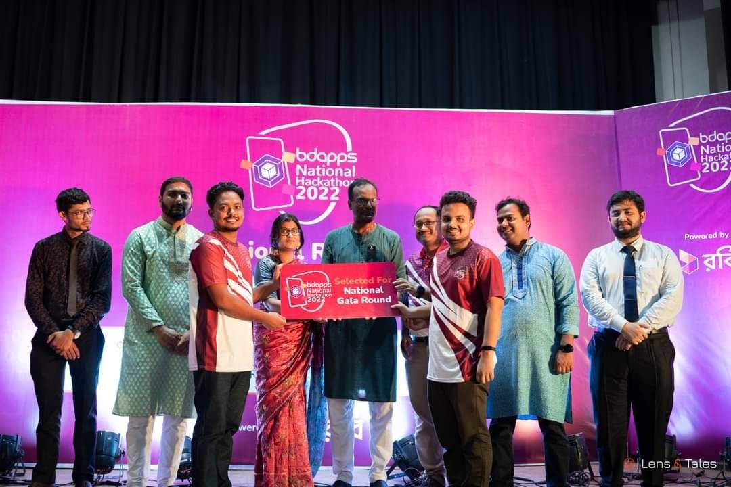
About Me
Md Shahriar Rahman
Software engineer @ OrangeBD
2 years+ industry experience
AWS certified Cloud Practitioner
bdapps National Hackathon Winner - 2022

Slide 3

Introduction to Cloud Computing
Cloud computing is the delivery of on-demand computing services—such as servers, storage, databases, networking and more—over the internet ('the cloud').
Compare cloud computing to utility services like electricity or water on-demand, scalable, and pay-as-you-go

Slide 4
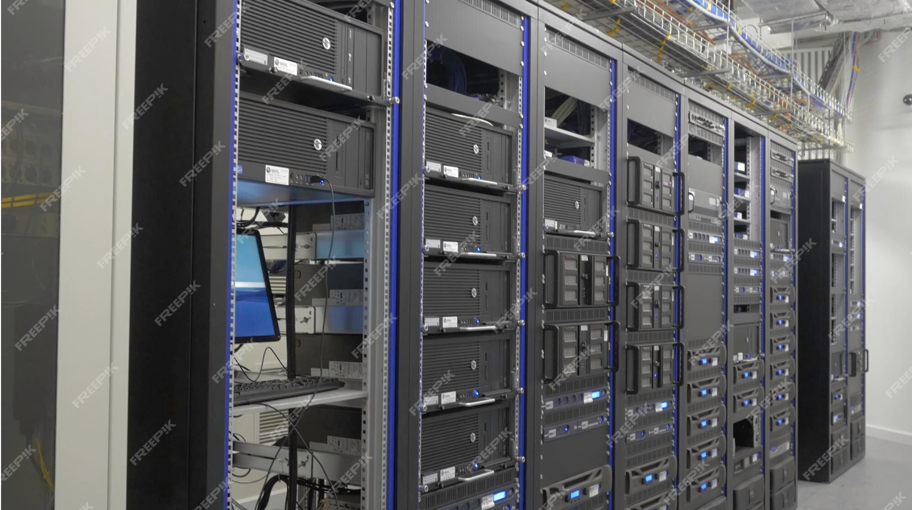
Server in Server Rack

Slide 5
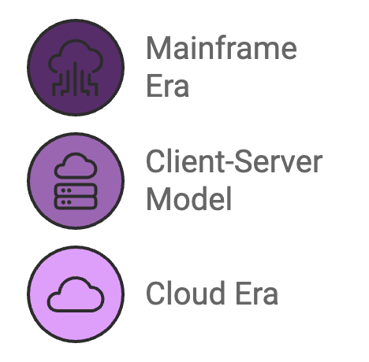
2. Evolution of Computing
Mainframe Era (1950s-1970s): Centralized computing, limited to large organizations.
Client-Server Model (1980s-1990s): Decentralized computing with personal computers and local servers.
Cloud Era (2000s-Present): On-demand, scalable resources available globally, thanks to advances in virtualization, internet speed, and storage.

Slide 6
3. Key Characteristics of Cloud Computing
On-Demand Self-Service: Users can provision resources automatically.
Broad Network Access: Available over the network, accessible from various devices.
Resource Pooling: Multi-tenant model with dynamic allocation.
Rapid Elasticity: Scale up/down based on demand.
Measured Service: Pay only for what you use.

Slide 7
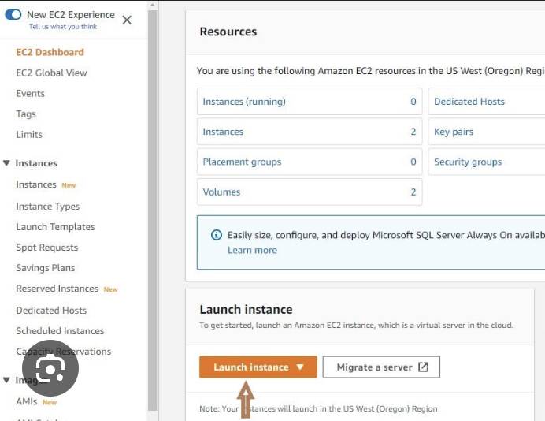
On-Demand Self-Service:
Users can access computing resources like servers and storage automatically, without human interaction with service providers.
Example: Launching a virtual machine (VM) on AWS.

Slide 8
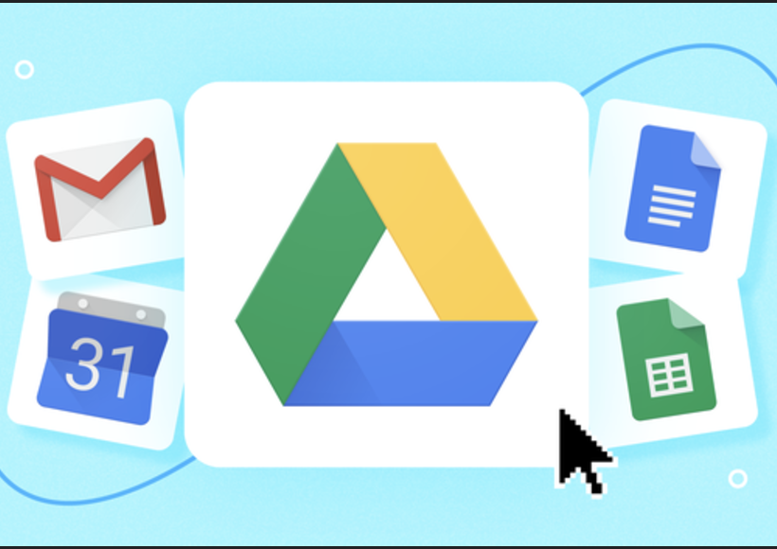
Broad Network Access
Services are accessible over the network via standard devices such as laptops, smartphones, or tablets.
Example: Accessing Google Drive from any device.

Slide 9
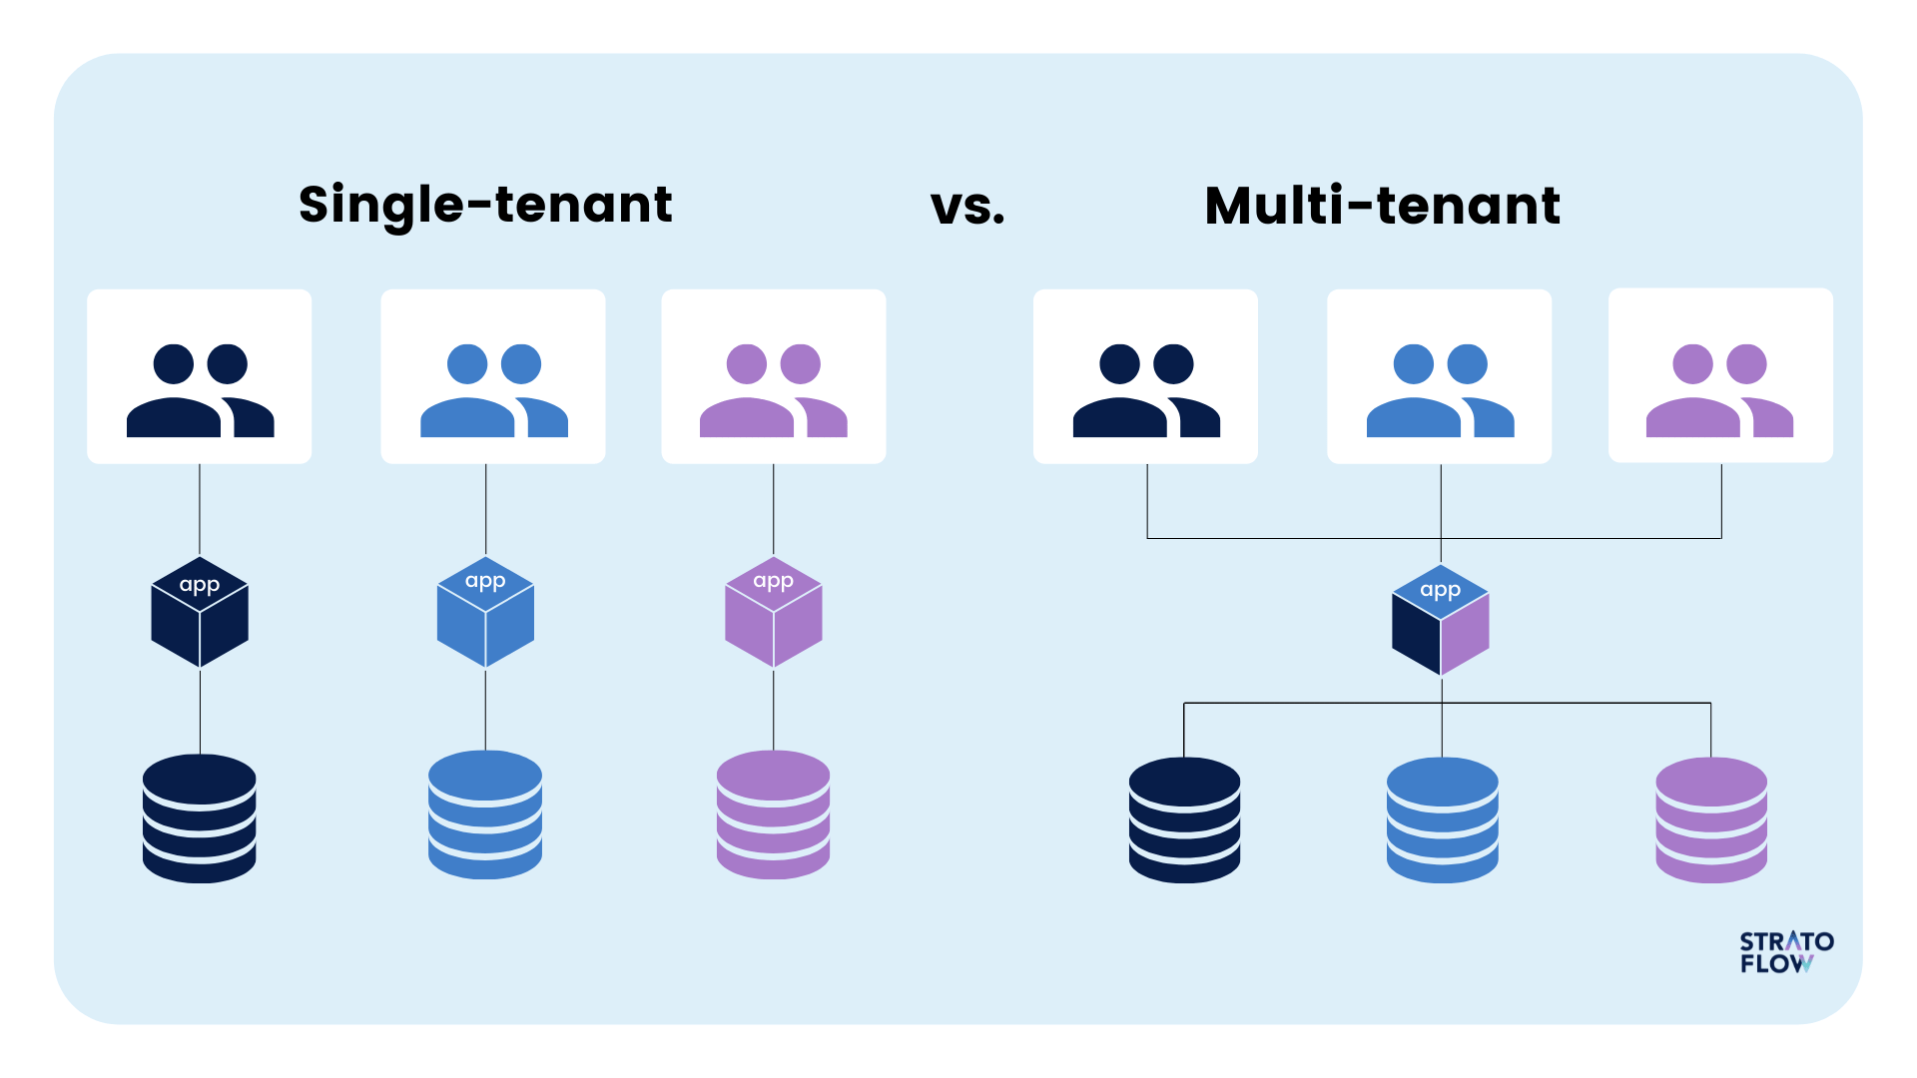
Resource Pooling:
Providers pool resources to serve multiple users using a multi-tenant model. Resources are dynamically assigned.
Example: AWS uses data centers globally to serve customers seamlessly.

Slide 10
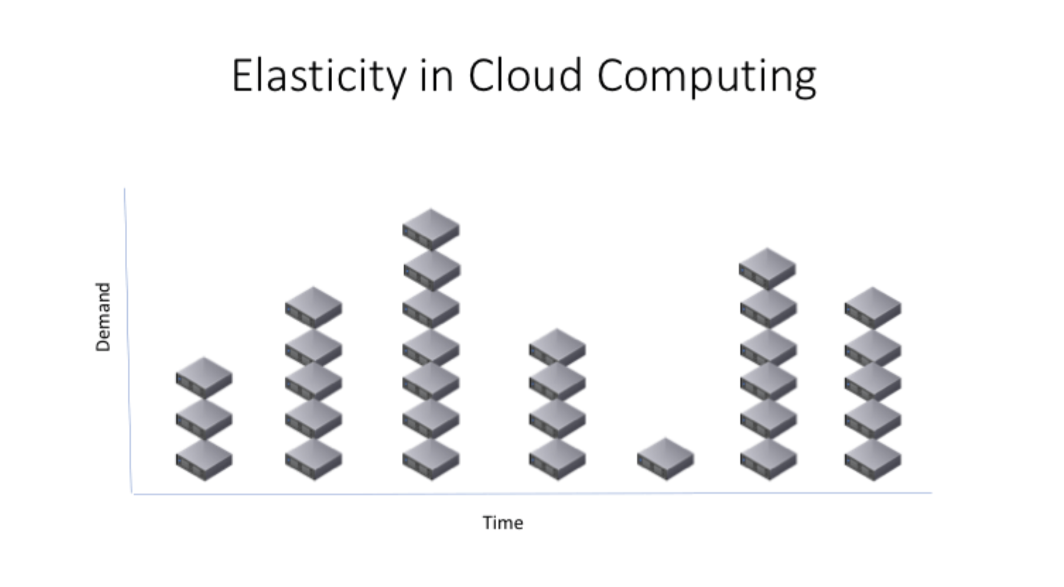
Rapid Elasticity:
Resources can be scaled up or down automatically or manually.
Example: E-commerce platforms scaling up during Eid sales.

Slide 11
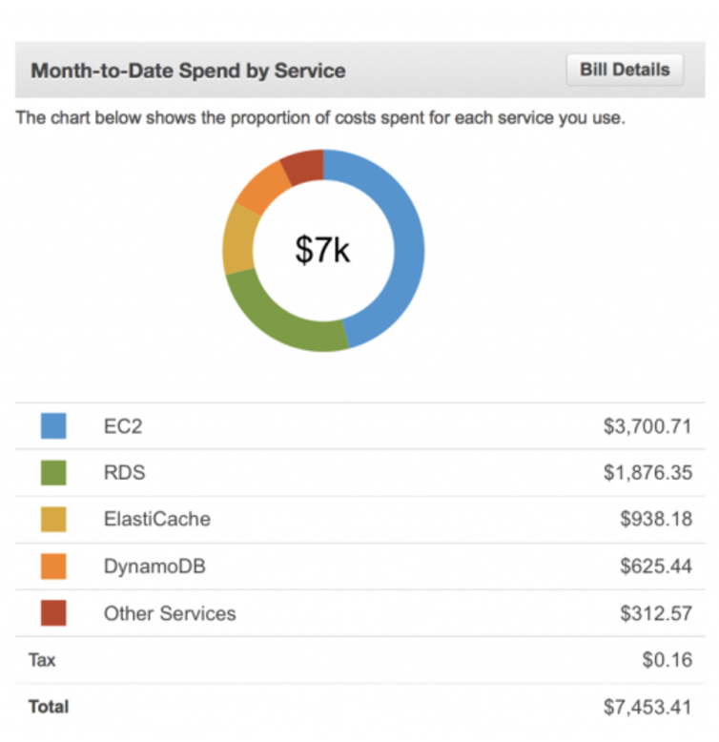
Measured Service:
Cloud systems automatically control and optimize resource usage, providing a metering capability.
Example: AWS bills based on the number of compute hours or storage used.

Slide 12
4. Cloud Service Models
IaaS (Infrastructure as a Service):
Example: AWS EC2, Google Compute Engine
Provides virtualized computing resources (VMs, storage, etc.)
PaaS (Platform as a Service):
Example: AWS Elastic Beanstalk, Google App Engine
Provides a platform for developing, testing, and deploying applications.
SaaS (Software as a Service):
Example: Gmail, Dropbox, Salesforce
Users access software over the internet without managing infrastructure.

Slide 13
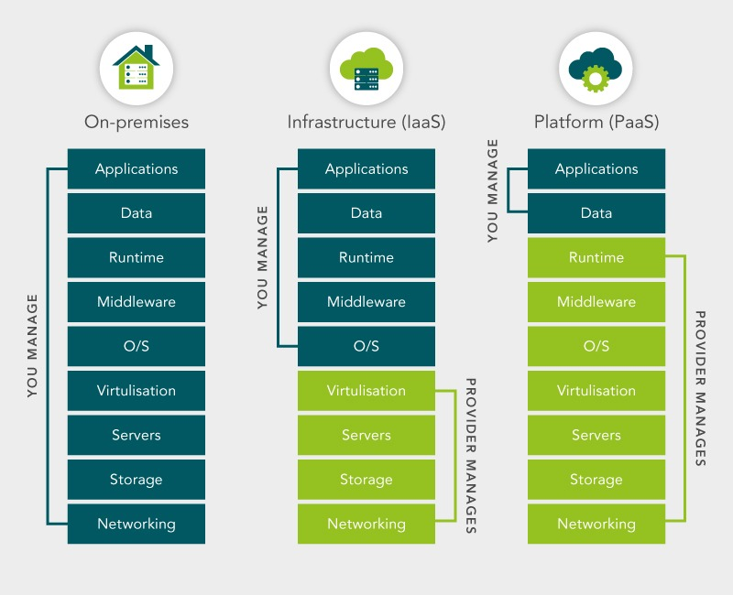
Responsibility Sharing

Slide 14
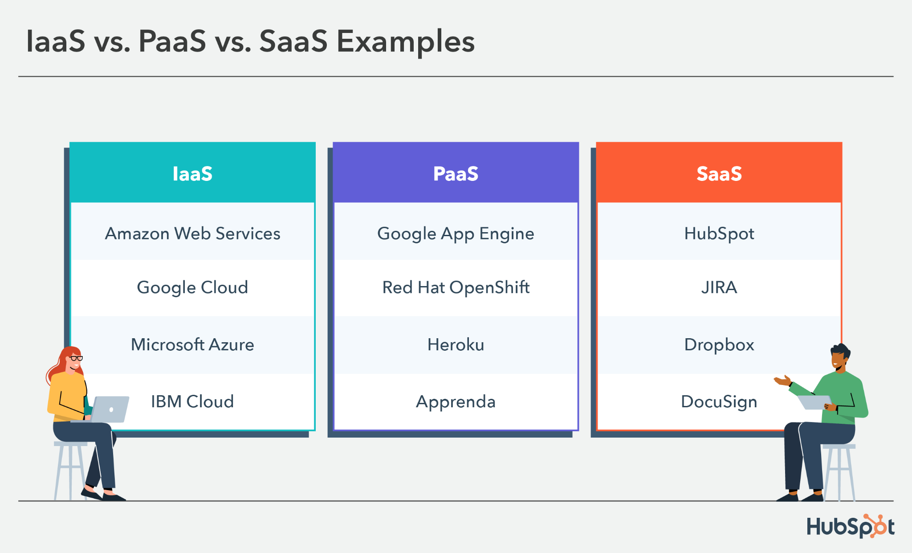

Slide 15
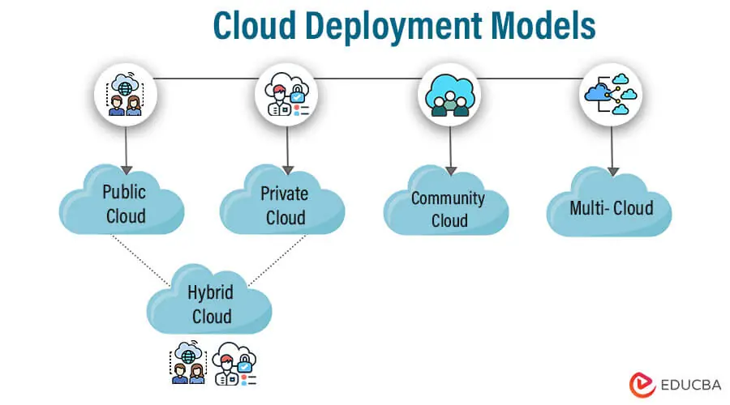
5. Cloud Deployment Models
Public Cloud: Services offered over the internet (e.g., AWS, Azure, GCP).
Private Cloud: Cloud infrastructure dedicated to a single organization.
Hybrid Cloud: Combination of public and private clouds.
Community Cloud: Shared by organizations with a common goal.

Slide 16
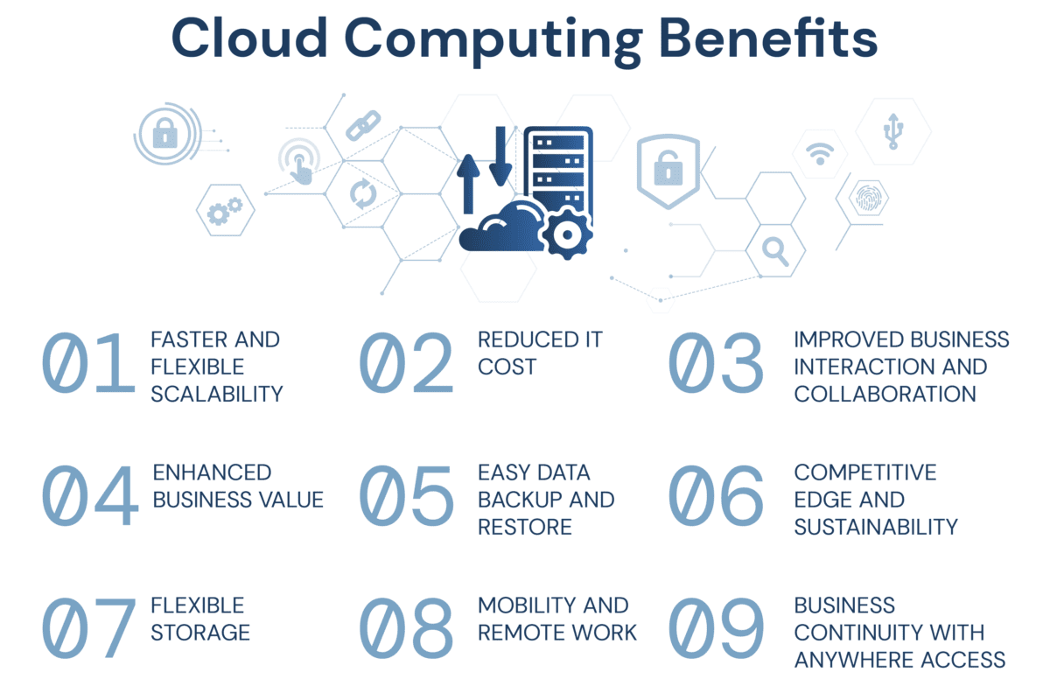
6. Benefits of Cloud Computing
1. Cost efficiency
2. Scalability and elasticity
3. High availability and redundancy
4. Innovation acceleration

Slide 17
7. Challenges in Cloud Computing
Data security and privacy (Cloud did not used in govt project)
Vendor lock-in
Downtime risks

Slide 18
Summary
Cloud computing delivers on-demand IT services over the internet.
Three service models: IaaS, PaaS, SaaS.
Four deployment models: Public, Private, Hybrid, Community.
Benefits include cost efficiency, scalability, and innovation, but challenges like security and vendor lock-in remain.

Slide 19

Thank You
Open for Questions
Connect with me in LinkedIn

